Slide 1
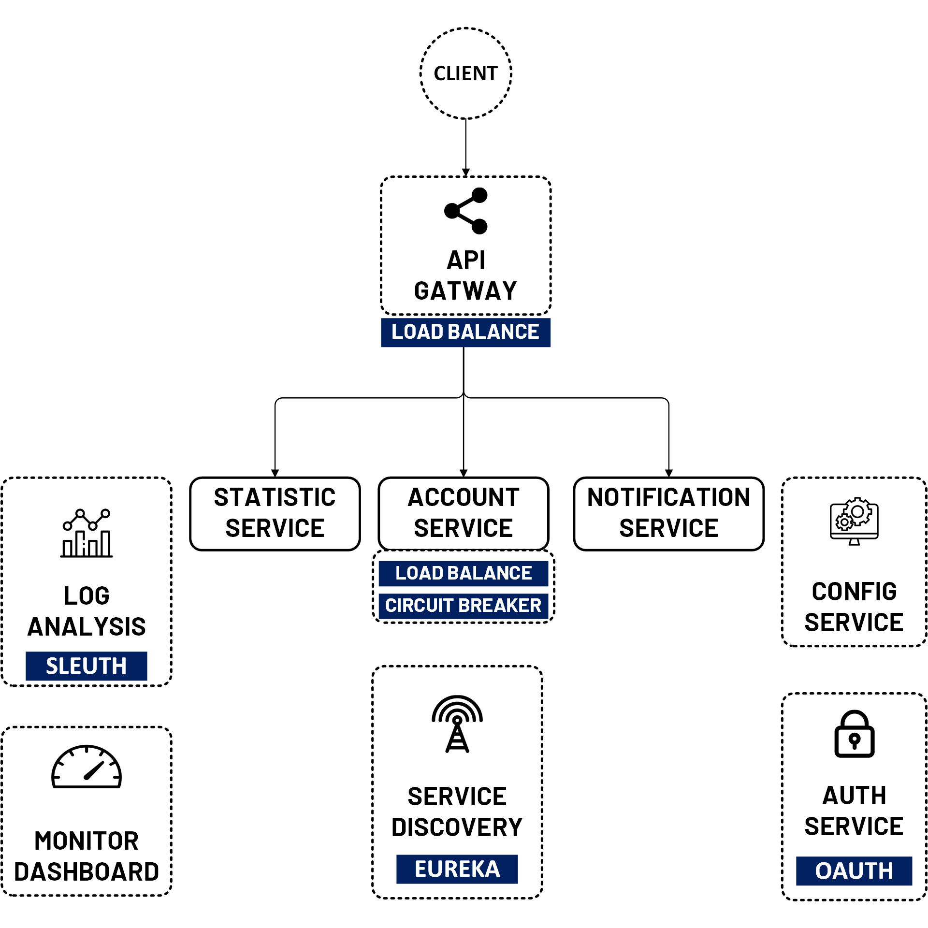

Front End JQuery with MicroService API
www.jmaster.io/course/microservices-with-spring-cloud

